Slide 1


Impact of COVID-19
on mental health
June 9th, 2023

Slide 2
C
ONTENTS
01
Introduction
02
Methodology
03
Results
04
Discussion
05
Conclusion & Limitation

Slide 3
01
Introduction
Background
Motivation
Contributions

Slide 4
Introduction
Background
Originating in Wuhan, China, in December 2019, COVID-19 has had a significant impact on the world over the past ten months, raising a range of issues including financial, economic, psychological and educational, with physical and psychological impacts on individuals.
manifestation
Lockdown
anxiety,
depression,
insomnia,
mood swings,
and distraction
Factors such as lifestyle, social intimacy, and success or failure in life led to an increased incidence of depression and anxiety.

Slide 5

Introduction
Motivation
Anxiety and depression scales are quantitatively reported through simulation and statistical reporting, based on datasets collected from various industries on their regular lifestyles, choices, and the internet. Use the report to understand people's post-COVID state of mind.

Slide 6

Introduction
Contributions
(1) Review of the conclusions of other literature
(2) Simulate people's current Psychological health
(3) Statistical analysis of the collected data
There are three main contributions to mental health analysis in the COVID-19 pandemic.

Slide 7
02
Methodology

Slide 8
Methodology
Data Collection
Time :
from 20 July 2020 to 1 August 2020
Scope of the investigation :
male and female 1 to 60 years old
Survey content :
to discover depression, daily use of the internet, and understand the psychological condition
We posted a questionnaire online to gather some psychological facts and some opinions on daily life.

Slide 9
Methodology
Development
(1) Organizing the qualitative data, we had given it a structured form.
(2) Deleting or removing unnecessary data.
(3) Converting the data into a quantitative dataset.
Qualitative data:
some questions
Multiple choices answers

Slide 10
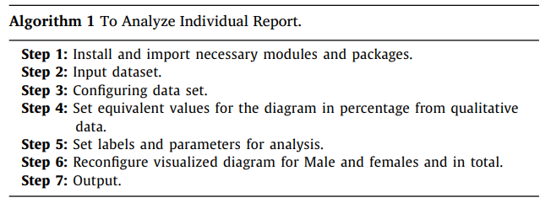
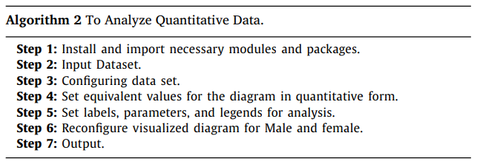
Methodology
Algorithm
(1) Organizing the qualitative data, we had given it a structured form.
(2) Deleting or removing unnecessary data.
(3) Converting the data into a quantitative dataset
Algorithm 1:
Analyzing the number of opinions of male and females by pie charts.
Algorithm 2:
Provide good view of the number of opinions of males and females and in total by count plots.

Slide 11
Methodology
Data Analysis
350 responses were recorded, including 237(67.7%) males and 113 (32.3%) females.
Most responses are form people of 18 to 23 years old.
Most of the answers were promising, but few of the answers were abnormal.
We have to implement the selected algorithms mentioned to visualize the data frame and give a statistical report.

Slide 12
03
Results

Slide 13
Results
According to the Survey, about 37.2% male, 49.8% female, and in total, 42.78% of people are depressed with their daily life. It can be referred to as the depression scale. According to the internet, we can say most people use all of the social services regularly. As a result, maximum time they stay at home. Mostly 63.7% of Females do not like to go out and then only for an hour (26.5%). On the other hand, 18.6% of male do not like to go out, and 26.5% of males go out for an hour. As a result, compared to the depression scale with the image remarking, we get 16.85% of people’s Psychological condition changes due to the lockdown of COVID-19.

Slide 14
04
Discussion
Depression scale
Internet use
Psychological change

Slide 15
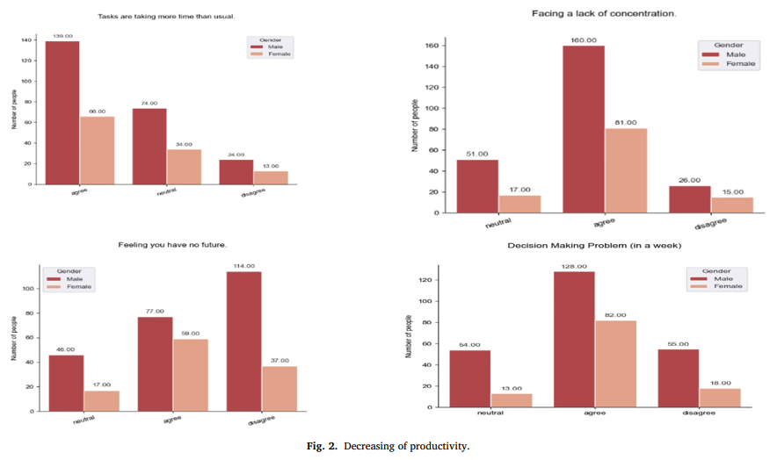
Decreasing of productivity

Slide 16
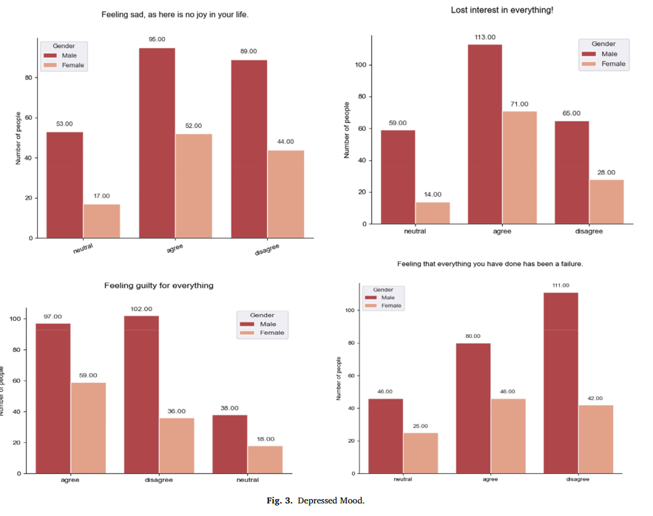
Depressed mood

Slide 17
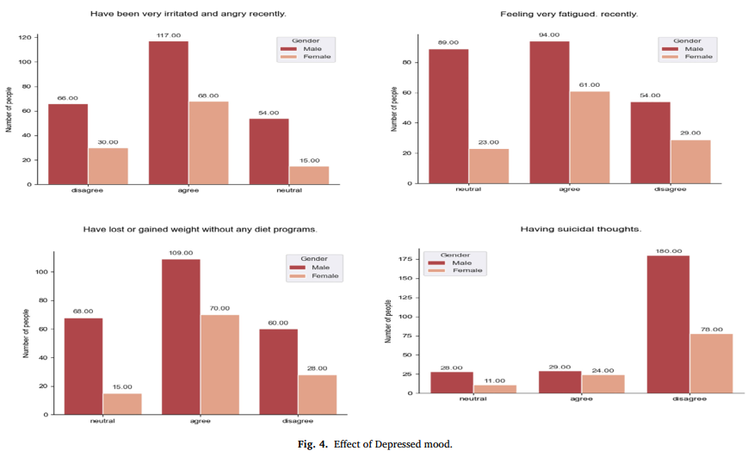
Effect of depressed mood

Slide 18
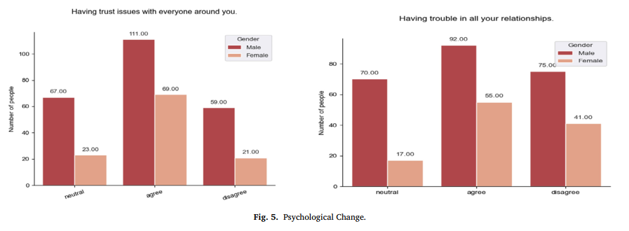
Psychological change

Slide 19
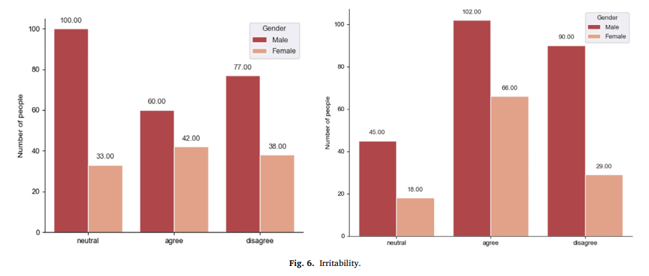
Irritability

Slide 20
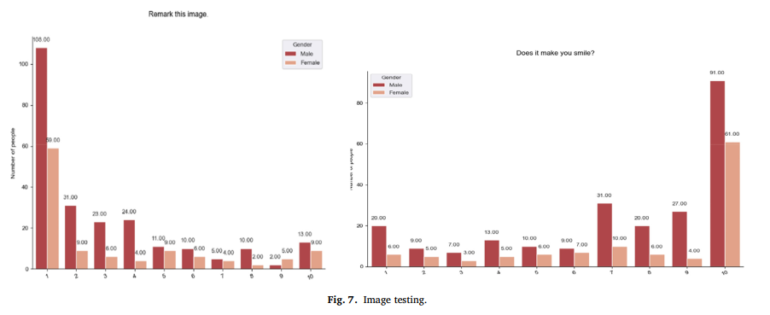
Image testing

Slide 21
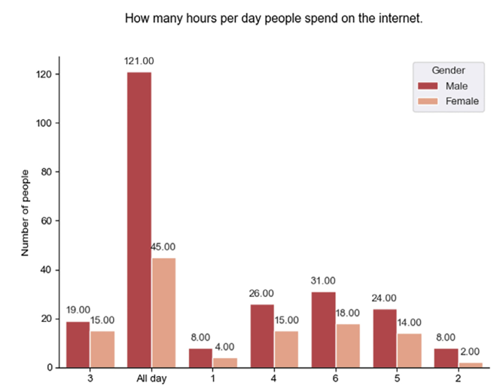
Spend time on the internet
(1) Organizing the qualitative data, we had given it a structured form.
(2) Deleting or removing unnecessary data.
(3) Converting the data into a quantitative dataset
Because many people are spending their time without doing anything due to the lockdown, they like to spend time on the internet.

Slide 22
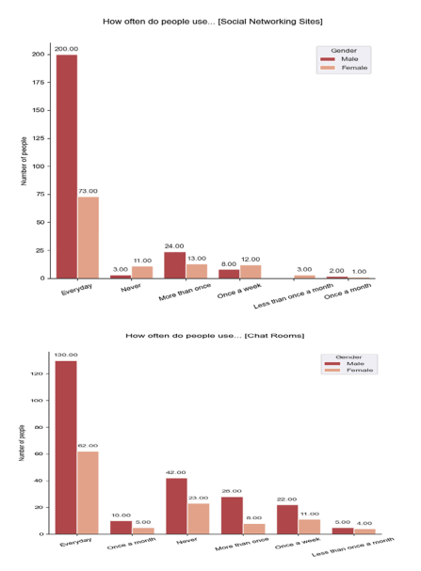
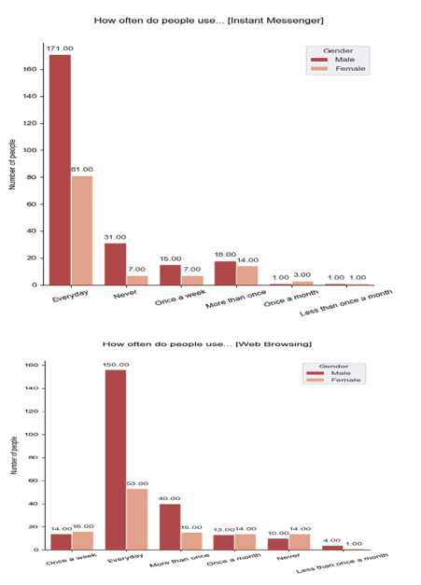
Most & average using internet sites

Slide 23
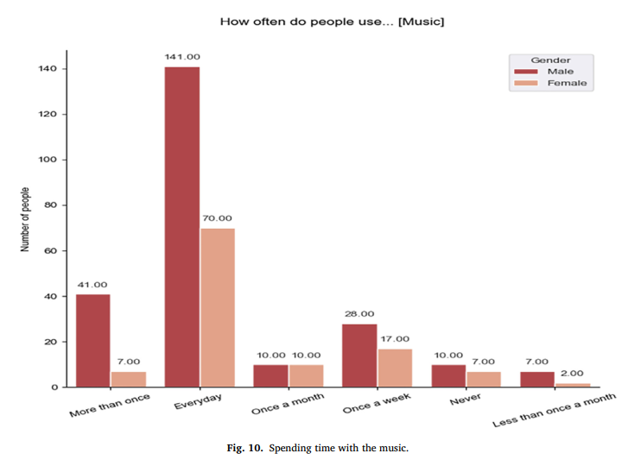
Spending time with the music
Maximum people agree that they like to listen to music continuously. It is seen that at the same time, we stay on social sites and also listen to music.

Slide 24
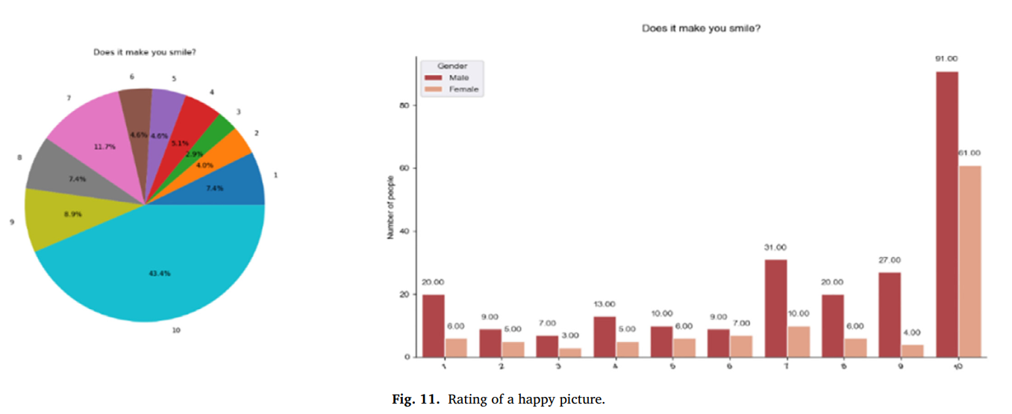
Psychological change

Slide 25
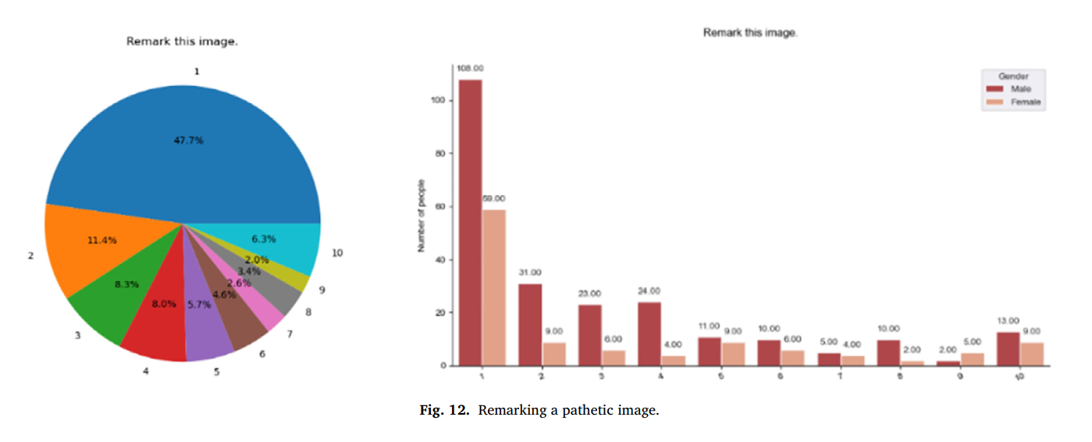
Psychological change

Slide 26
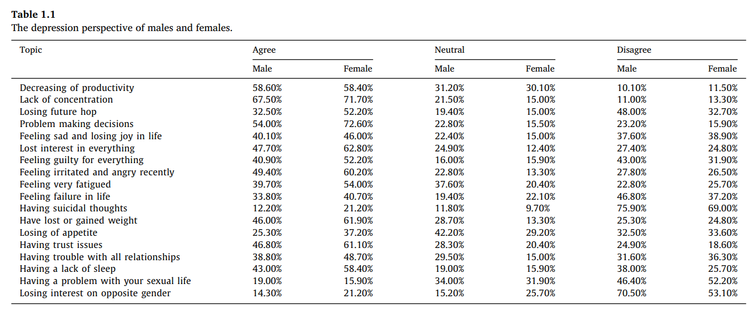
Psychological change

Slide 27
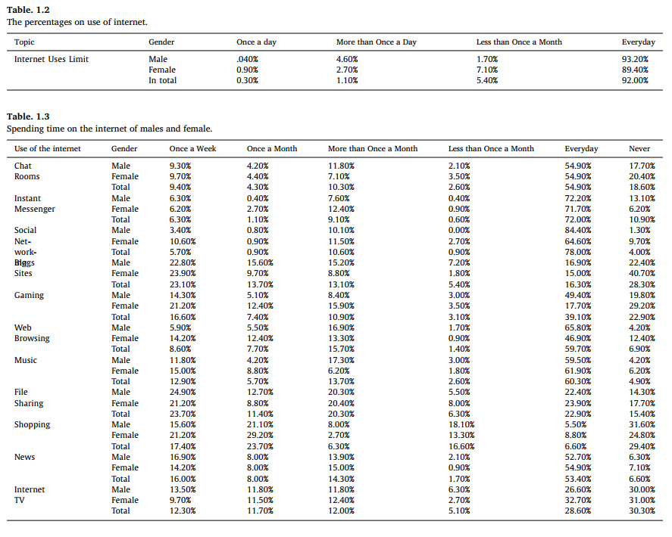
Psychological change

Slide 28
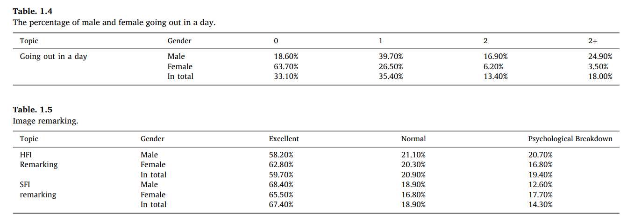
Psychological change

Slide 29
05
Conclusion & Limitation

Slide 30
Conclusion
COVID-19 has a significant impact on mental health.
It is creating a destructive mentality and increasing depression in regular life. As a result, suicidal attempts are increasing.
Life of people are becoming more irritable, and people have social anxiety.
Social distance has increased and physical contact is decreasing. Social colony breakdown is the main reason for this.
As people have to stay at home most of the time, they spend their leisure time on the internet. The natural lifestyle of humans is being hampered.

Slide 31
Limitation
Only 350 people responded to the Survey.
Only those people who use the internet could get a response to our Survey.
Most of the responses were from the student, so there is a small number of data from other professions.

Slide 32
Thanks!
June 9th, 2023

